Slide 1
Data Mining & Machine Learning
Name: ZAIGHUM JAWAD ASLAM
Matricola: D03000118
University Of Naples Federico II
Project :
Morphological Classification of Extragalactic Radio Sources Using Gradient Boosting Methods
Category : Image Processing

Slide 2
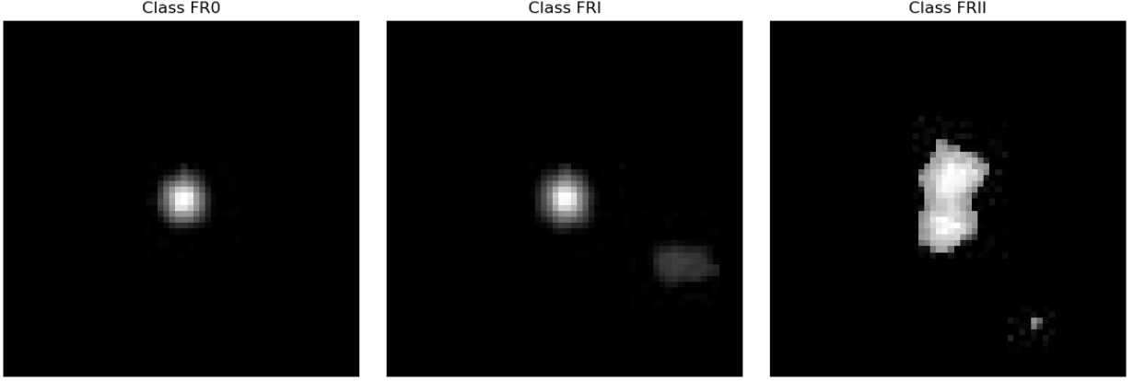
Dataset Analysis
Image Based Dataset comprising 3 folders , 13,140 pictures.
Represents a galaxy out of images in three classes FR0,FRI,FRII.
300x300 greyscale format pictures obtained.
FR0 is characterized by weak radio jets, compact and symmetric morphology.
FRI is characterized by asymmetric radio jets, smaller galaxies in dense environments.
FRII is characterized by clear difference in brightness levels, lobes, obtained by more powerful radio sources.

Slide 3
Project Objective
Since it is a multiclass classification, the objective is to identify an image based on same morphology to classify it into a galaxy or not.
Hence FR0, FRI , FRII would be the classes that are primarily used and out of source images can be used to identify using CNN Model.
CNN can classify the image which is the main objective or target of this project

Slide 4
Challenges In Dataset
FR0 being majority class containing double the images than FRI, FRII (Imbalanced Dataset).
Varying Image Quality like some images blurred, more noisy, distinctive shapes, inconsistent quality are gathered.
Presence of noise and black images in images containing purely black background and foreground with little to no extractable features.
All these sort of data can cause under sampling, over sampling, inconsistent model performances because they are useless and can be considered as outliers.

Slide 5
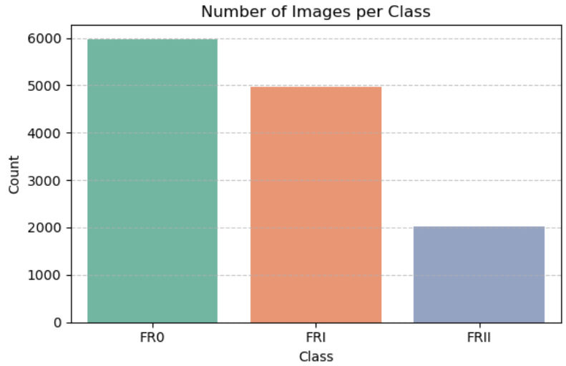
Handling Dataset Challenges
The total number of images were found out to be:
FR0 containing 6066
FRI containing 5008
FRII containing 2066
Representing majority in one class than the rest!
A Plot representing the class representation is also clearly depicting the all three classes FR0,FRI,FRII respectively.
This imbalance is then later adjusted by Data Augmentation Technique

Slide 6
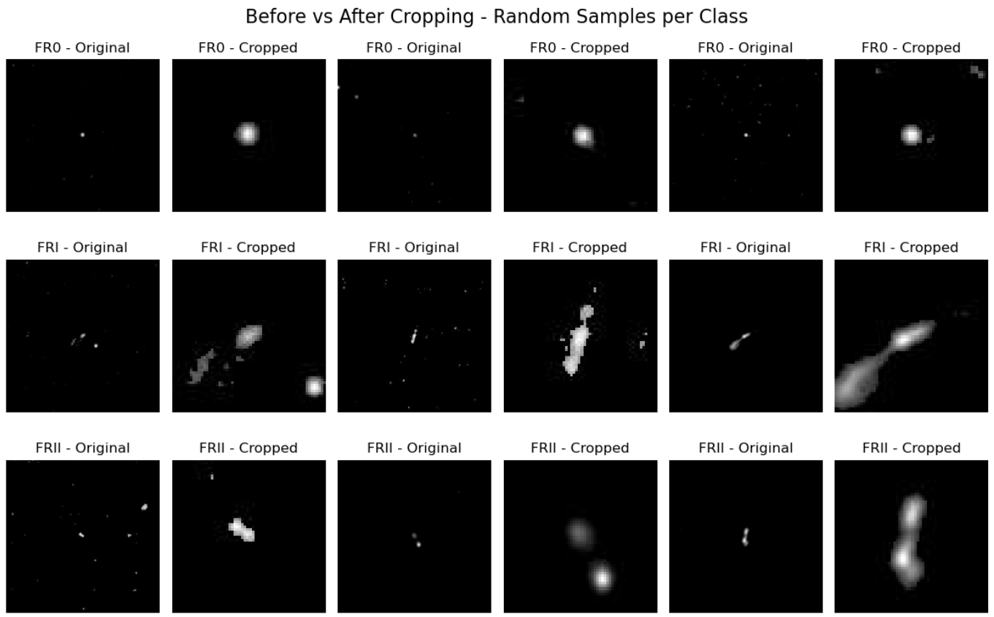
Image Preparations
All images from their respective paths were first loaded and labels were assigned to them as FR0 as 0 , FRI as 1 , FRII as 2.
Cropping is used to scale images as 60x60 instead of 300x300 as zoomed in middle of each image.
Normalization Technique is used to reduce pixel range to [0,1] instead of 0 to 255, because it brings all input features to similar scaling.
Some image samples are visualized consisting above executions

Slide 7
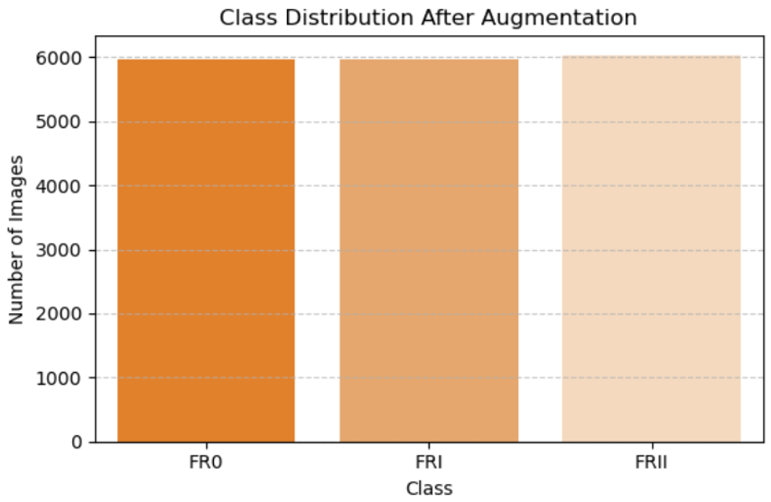
Handling Class Imbalance
FR0 being a majority class with most pictures.
Reducing FR0 is not worth it as it might reduces some important feature images.
Hence, Balancing the remaining classes by augmenting the data from FR0 will be the best approach so as to match the overall class distributions.
Use random transformations to create synthetic data that mimics real-world variations.

Slide 8
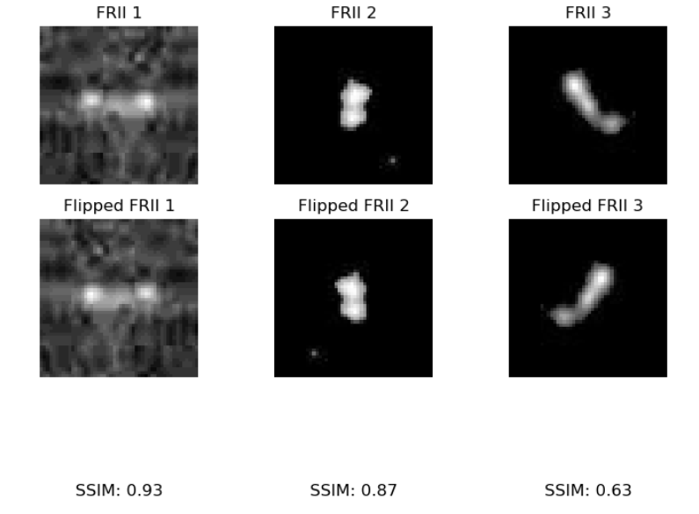
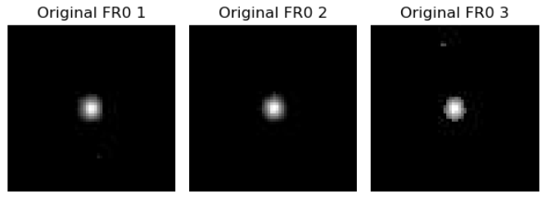
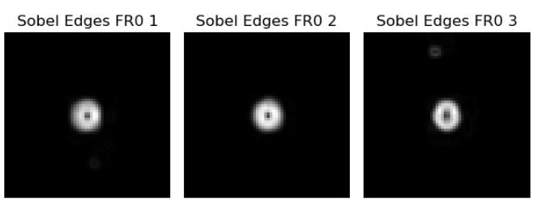
Handling Class Imbalance (Techniques)
Rotation: Random rotations within a 30-degree range, making the model invariant to orientation.
Translation (Shifting): Images were shifted horizontally and vertically by up to 20%, simulating positional shifts.
Zoom: Random zooming was applied to simulate variations in scale.
Flipping: Horizontal flipping to create mirrored images and simulate symmetry.
Impact on Dataset: 1000 new FRI images generated, 4000 new FRII images generated.

Slide 9
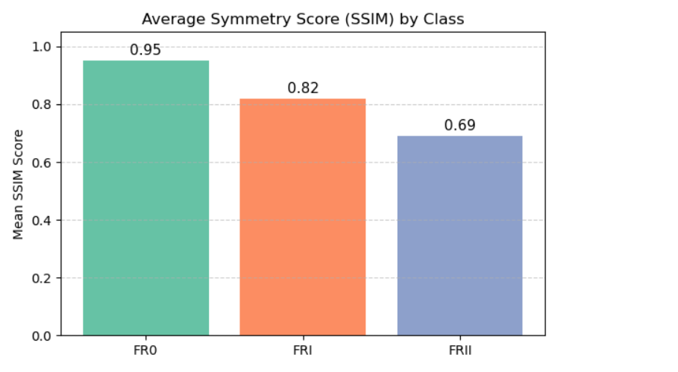
Symmetry Scores
Symmetry analysis on the images of the three classes (FR0, FRI, and FRII) to understand the structural similarities between each class and its flipped version.
Achieved by calculating the Structural Similarity Index (SSIM) between the original images and their horizontally flipped counterparts

Slide 10
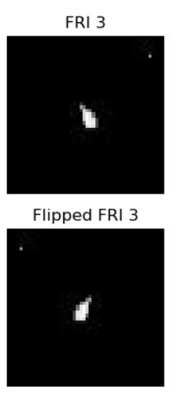
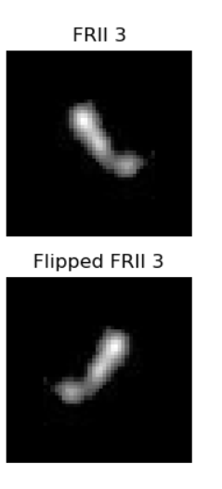
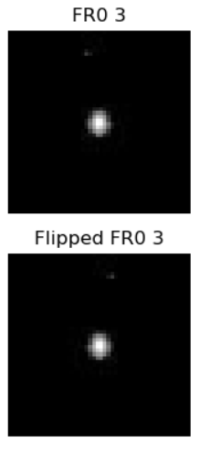
Analysis of Symmetries
FR0 images had a high symmetry score of 0.95, indicating that the images in this class are highly symmetric.
FRI images showed a moderate symmetry score of 0.82, meaning that while the images in this class are fairly symmetric.
FRII images, on the other hand, had the lowest symmetry score of 0.69, suggesting a significant lack of symmetry.

Slide 11
Normalization of Images
By dividing the original image data by 255, all pixel values are transformed into the range of [0, 1].
This step improves the efficiency and performance of machine learning models, as neural networks tend to perform better when the input data is within a small, consistent range.
Original Min: 0, Max: 249 (Original pixel range)
Normalized Min: 0.0, Max: 0.976 (Normalized pixel range)

Slide 12
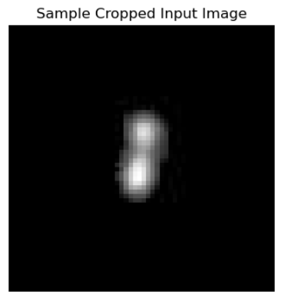
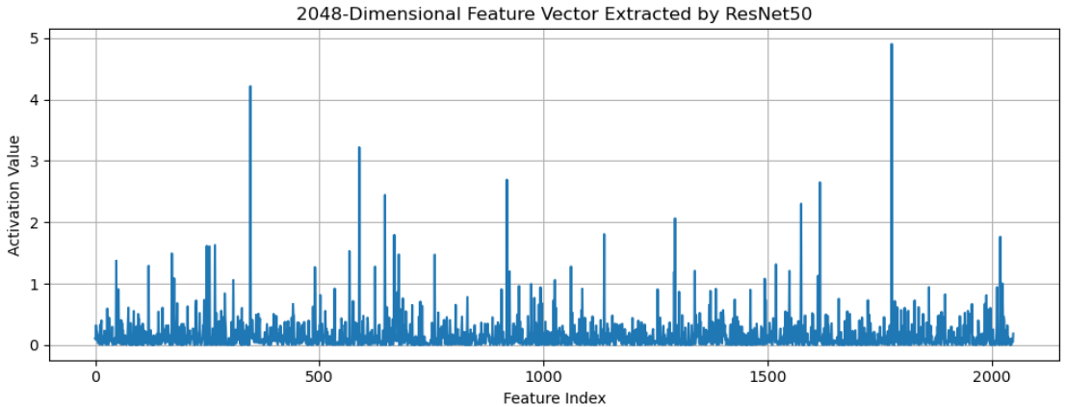
Feature Extraction (ResNet50)
Preparations of the dataset and performing train , test split on the dataset for efficient.
Pre-trained model on ImageNet therefore viable and suitable.
features represent high-level information about the image, such as textures, shapes, and patterns.
Features useful for the next models.
224x224 pixels as input image
Greyscale to RGB 3 channel information as output.

Slide 13
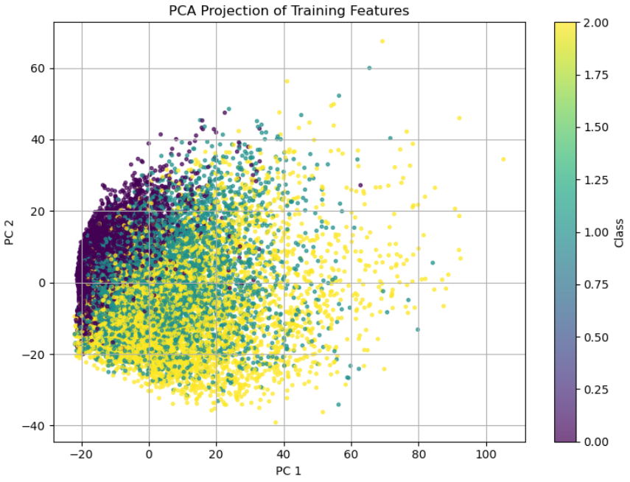
PCA Analysis
Principal Component Analysis (PCA) was applied to reduce the dimensionality of the features extracted using ResNet50.
A 2D PCA projection was visualized using the first two principal components (PC1 and PC2). This 2D scatter plot helps to visualize how the data points from different classes (FR0, FRI, FRII) are distributed in the reduced feature space.

Slide 14
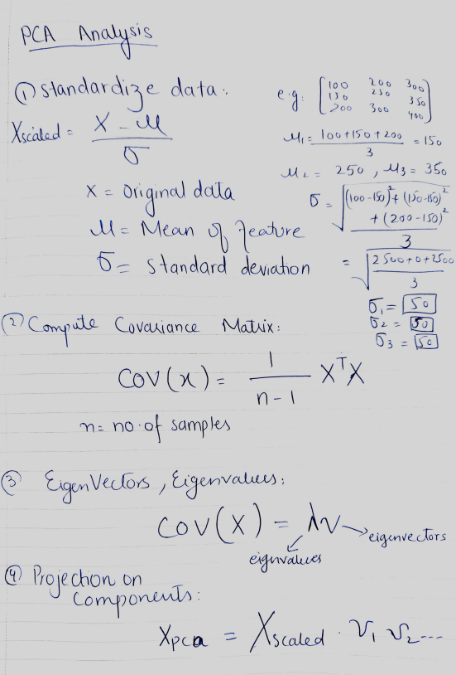
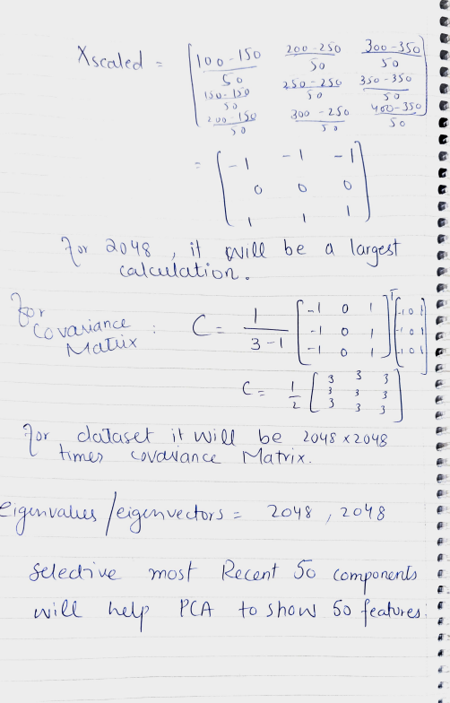
Sample Calculation

Slide 15
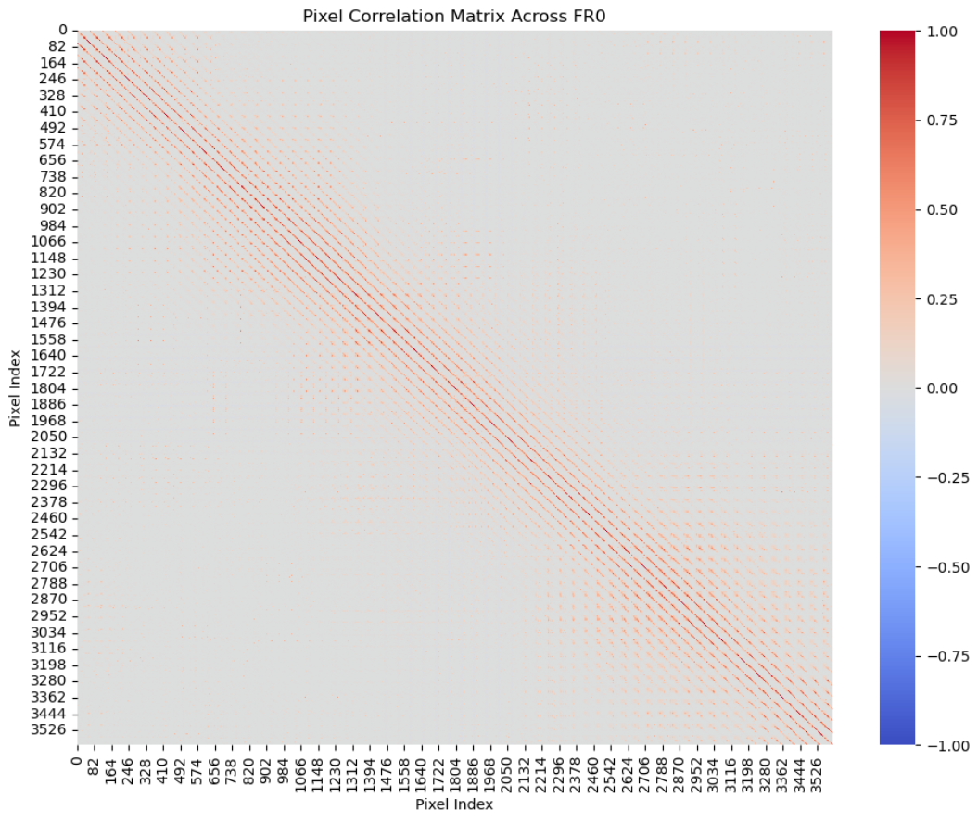
Further Correlation Analysis
Uncover structural patterns and relationships at the pixel level across classes.
Each image was converted from its 2D matrix form into a 1D vector (flattened).
Easier computation of correlations across the entire image.
Exploring structural relationships between different classes.

Slide 16
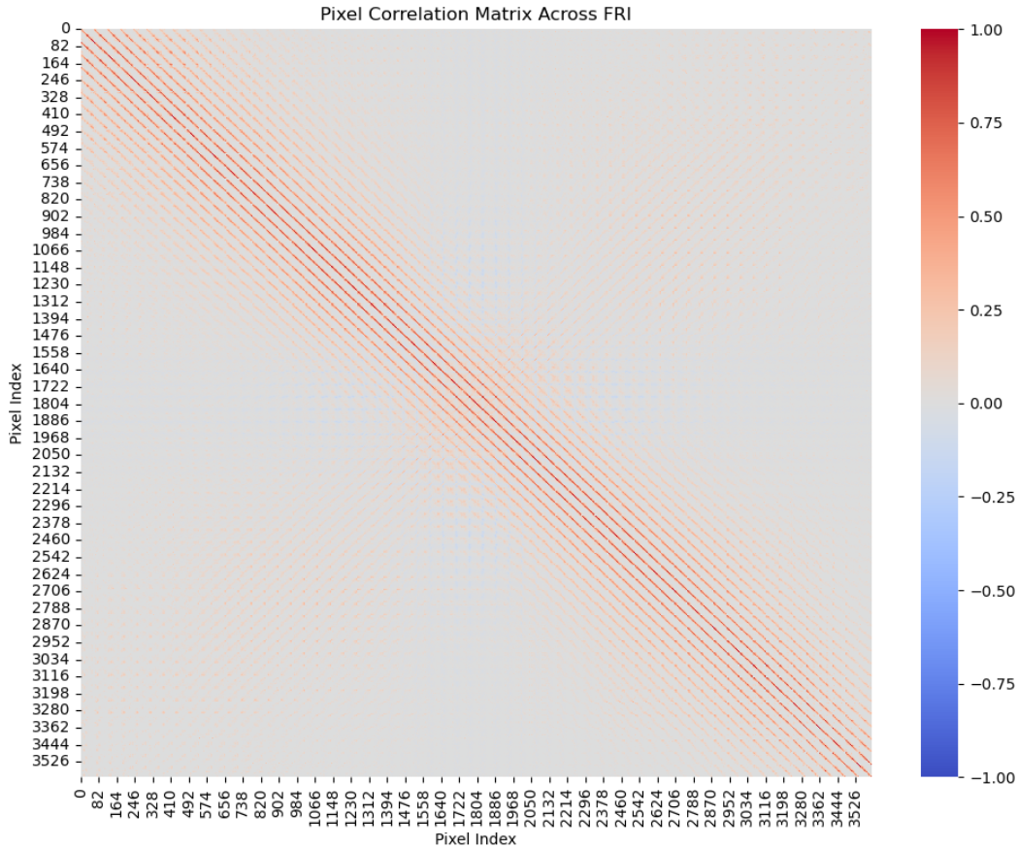
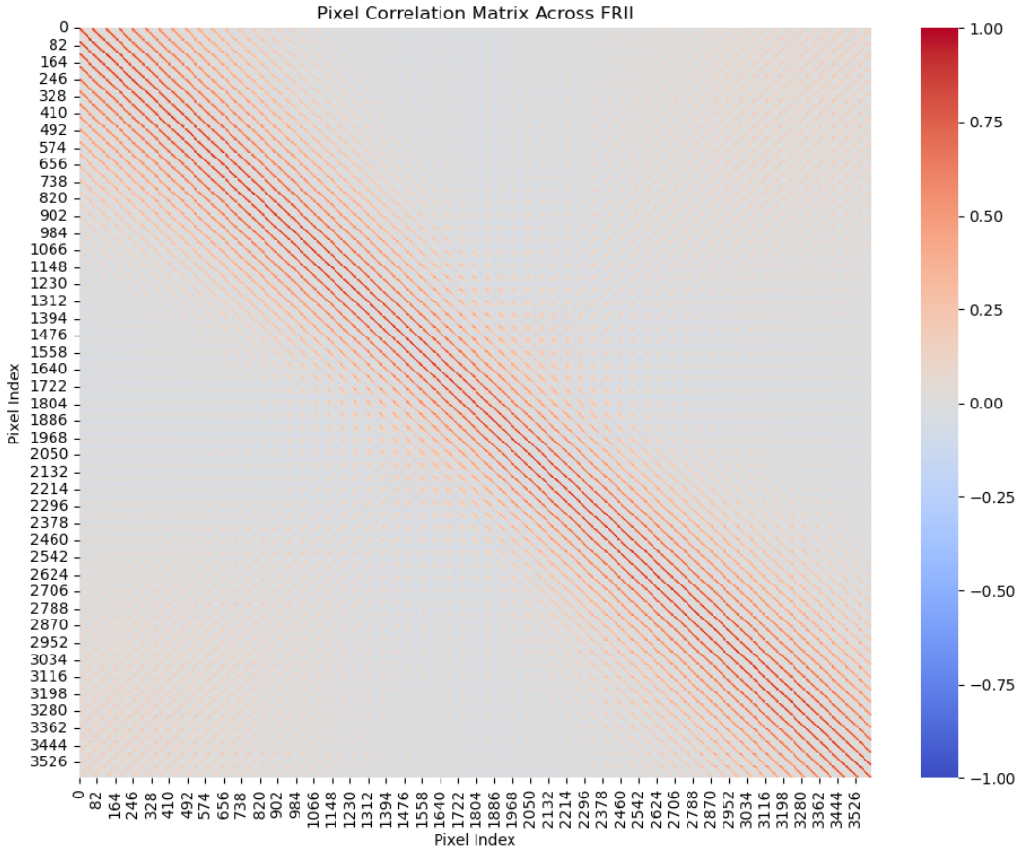
Continue’d

Slide 17
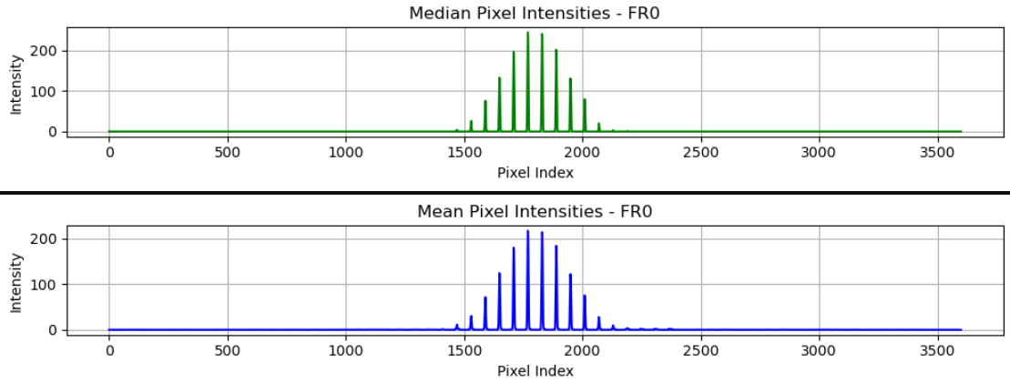
Mean Median Pixel Intensities (FR0)

Slide 18
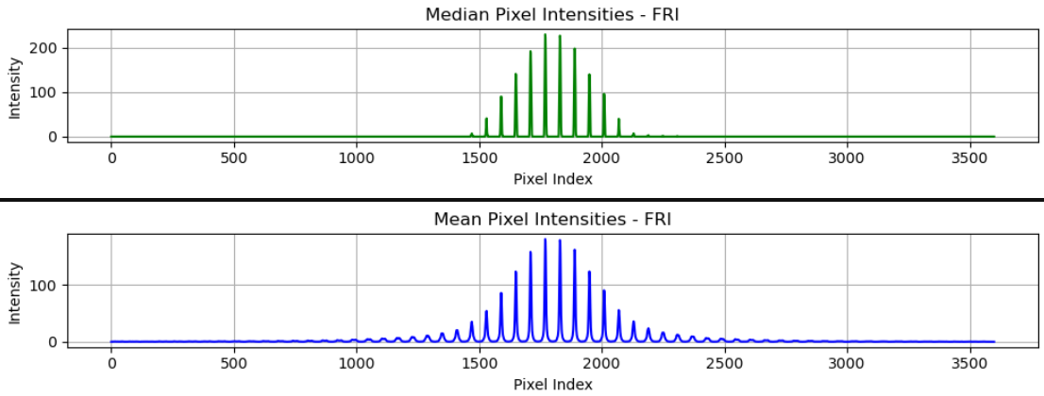
Across FRI

Slide 19
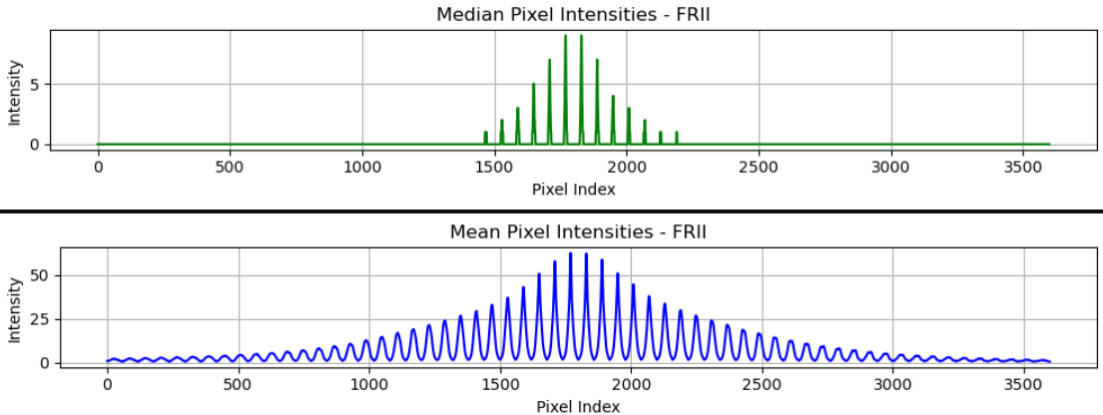
Across FRII

Slide 20
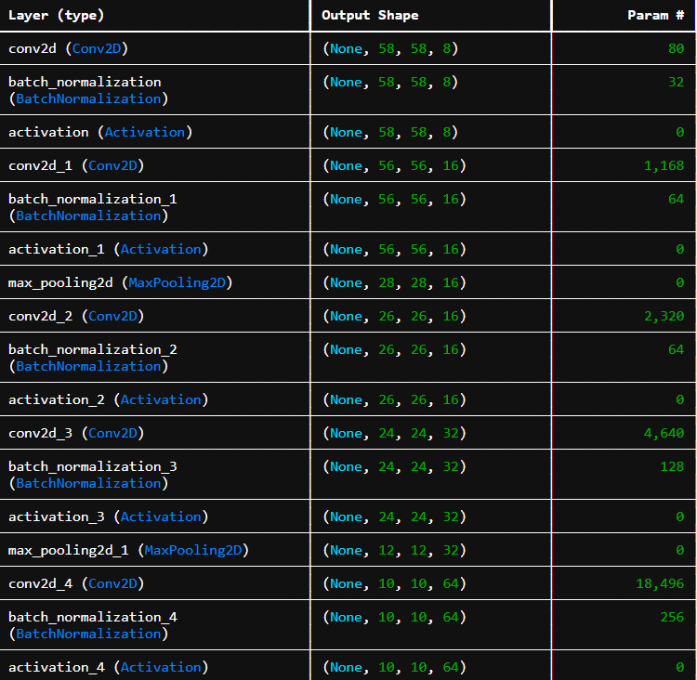
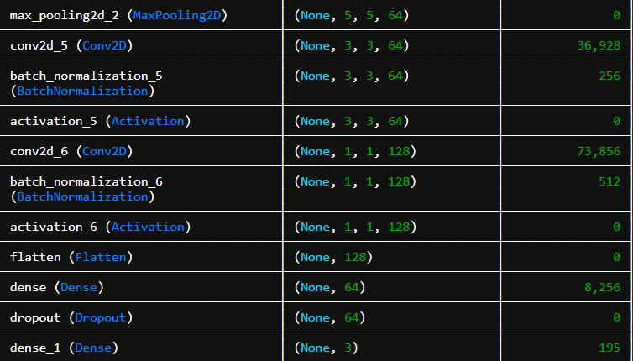
CNN Model Selection
Series of Conv2D layers, which are the primary layers used in CNNs for feature extraction.
The convolution layers gradually increase in the number of filters (8 -> 16 -> 32 -> 64 -> 128) as we go deeper into the network, allowing the model to capture more intricate patterns.
Total parameters: 147,251
Trainable: 146,595
Non-Trainable: 656

Slide 21
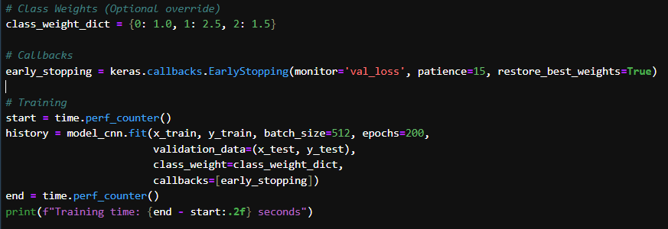
CNN Model Configuration

Slide 22
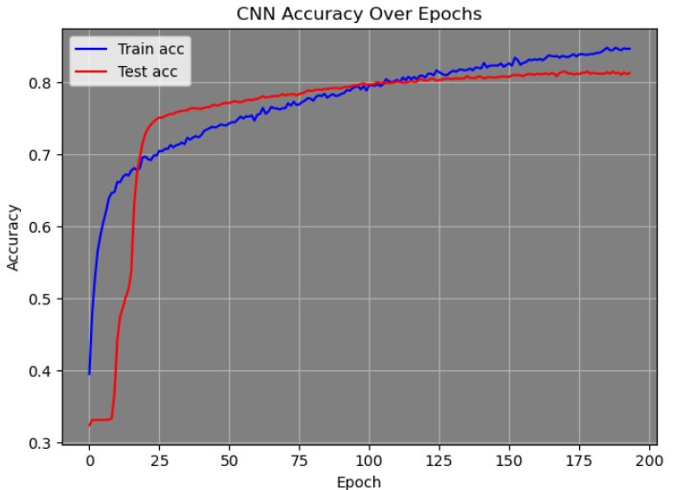
Accuracy Plot

Slide 23
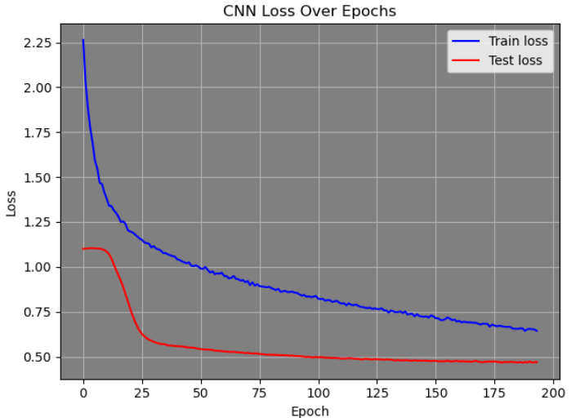
Loss Over Epochs

Slide 24
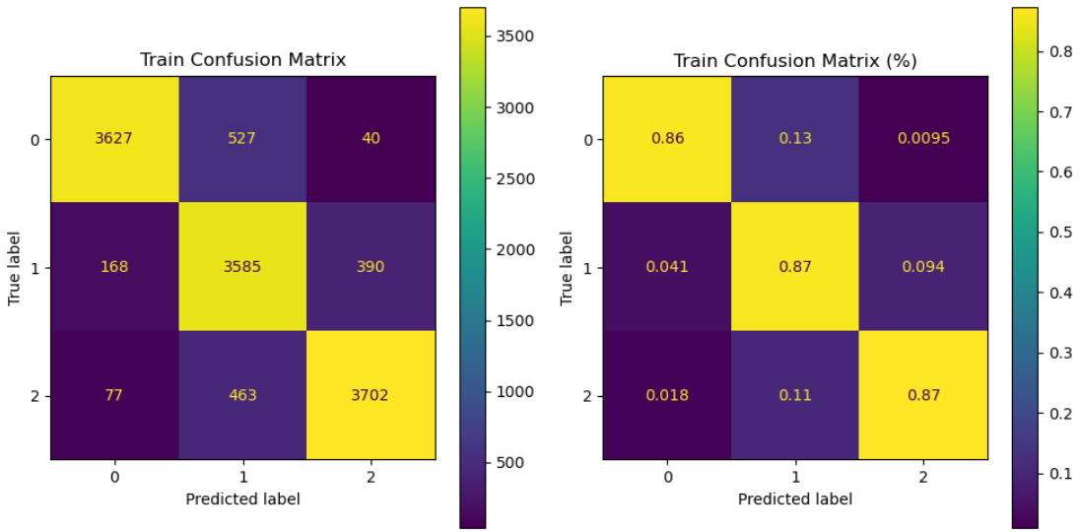
Confusion Matrix (Training)
Train Accuracy : 0.86
Test Accuracy : 0.79

Slide 25
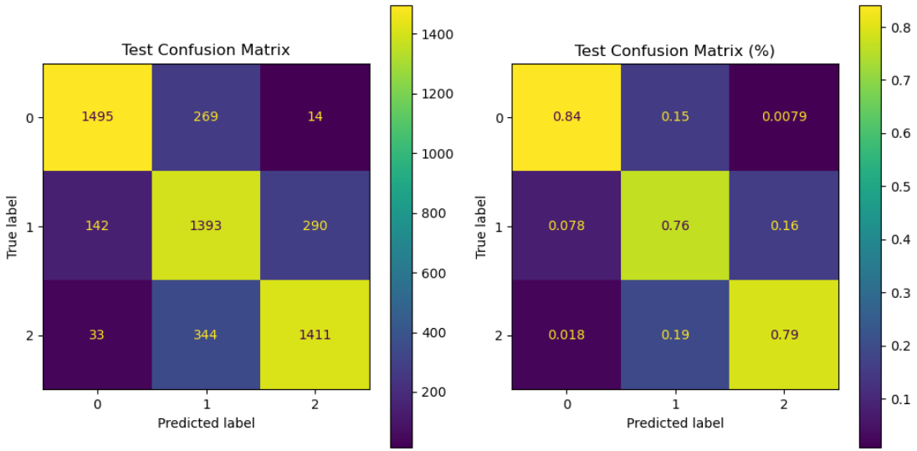
Confusion Matrix (Test)

Slide 26
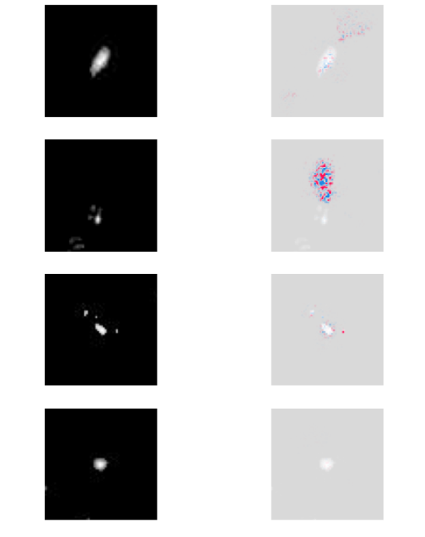
Model Explainability
SHAP (SHAPLEY ADDITIVE EXPLANATIONS) is a framework used to explain the output of machine learning models.
contribution of each input feature, useful for interpreting complex deep learning models, such as CNNs.
make the model interpretable by showing which parts of the image influenced the prediction.
Red regions = positive contribution
Blue regions = negatively contribution

Slide 27
MODEL II (XGBOOST)
Accuracy | 81.41%
Precision | FR0: 0.86, FRI: 0.78, FRII: 0.79
Recall | FR0: 0.91, FRI: 0.66, FRII: 0.87
F1-score | FR0: 0.88, FRI: 0.72, FRII: 0.83
Observation: The model performed best for FR0 and FRII, but struggled more with FRI, likely due to overlap in feature distribution.

Slide 28
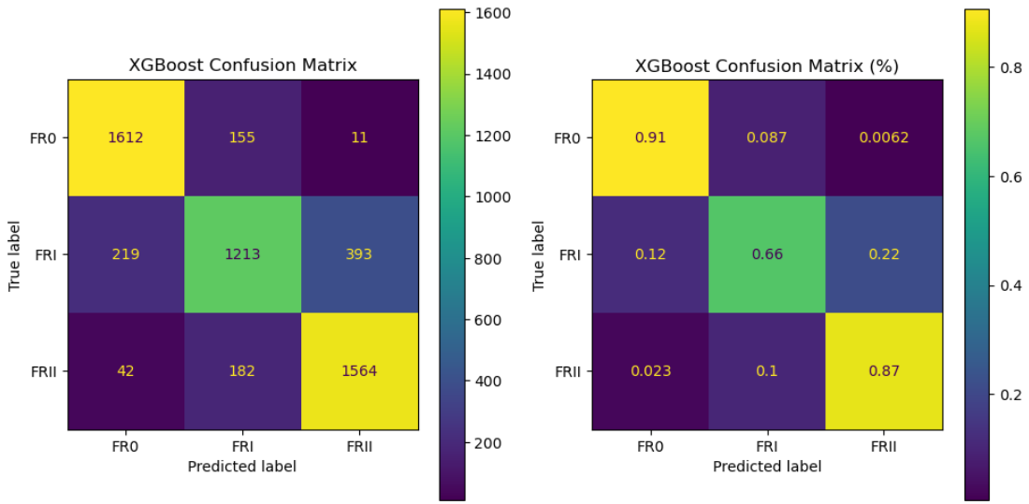
Confusion Matrix (XGBOOST)

Slide 29
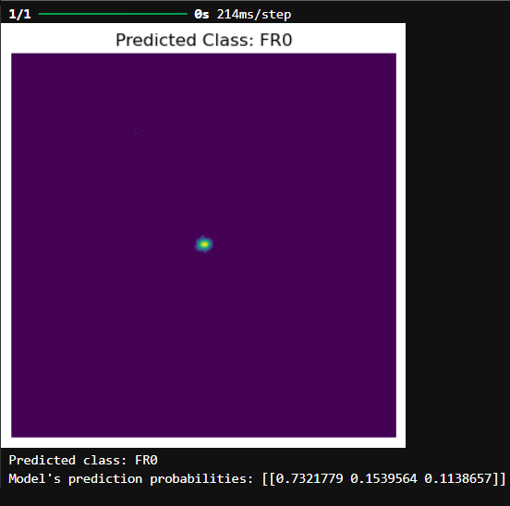
CNN Performance on Predictions
Step 1
Trained Model saved and loaded.
Step 2
Preprocessing happens on image.
Step 3
Pass the processed image to the model, which outputs the predicted class probabilities.
Step 4
Show the original image with the predicted class displayed as the title.

